Slide 1
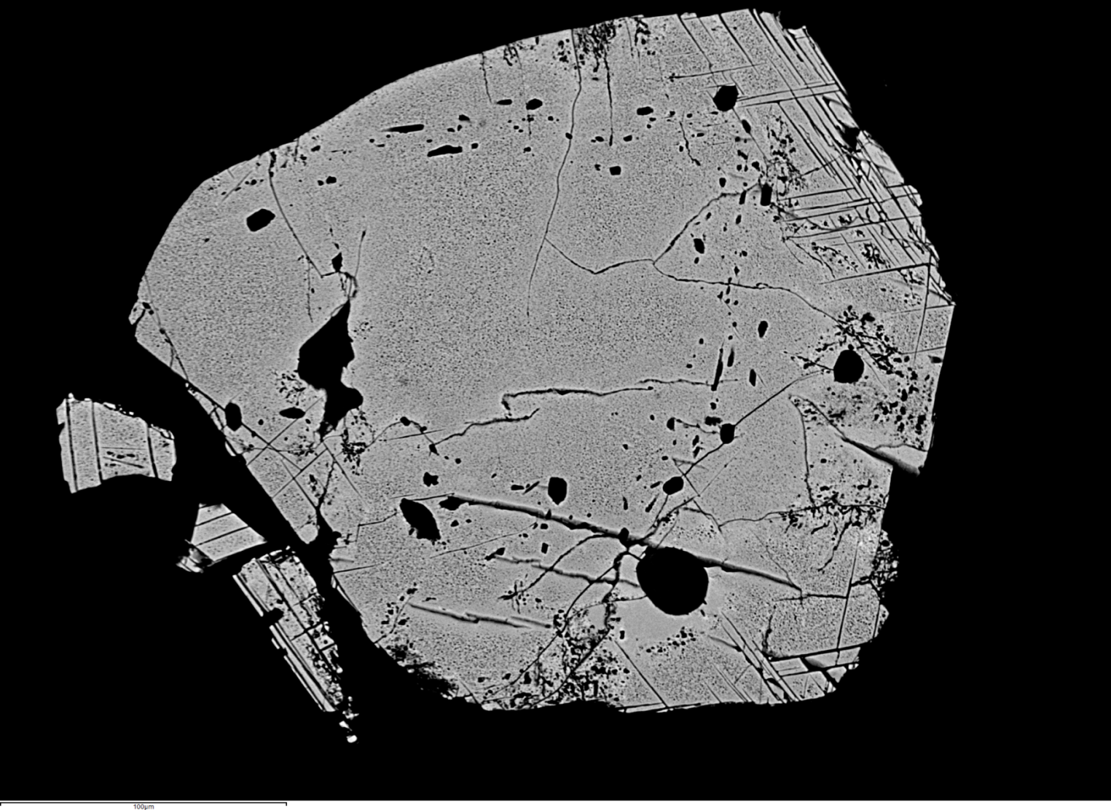




Developing magnetite as a petrogenetic indicator to interpret conditions conducive for forming porphyry copper deposits
Scarce Resources
Workshop
Kazakhstan
September 2016
Rob Sievwright
PhD candidate

Slide 2
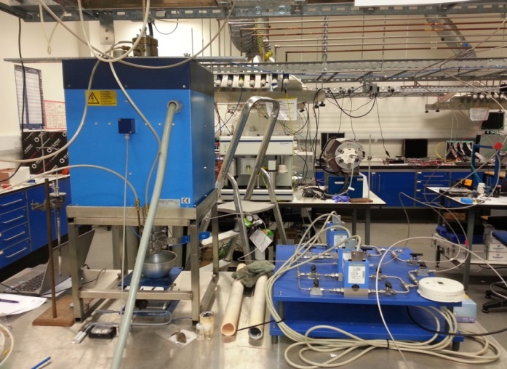
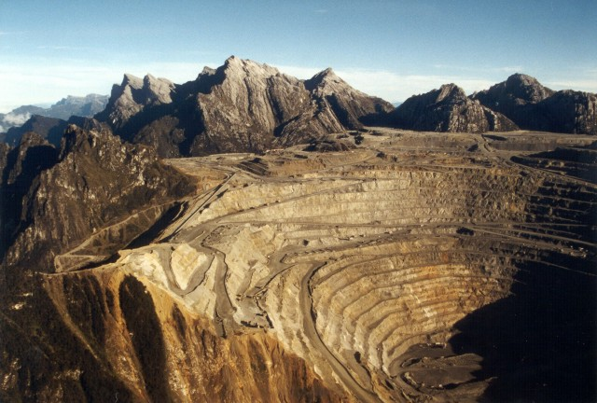
PhD Project Overview
Phase 1 (Experimental)
  Magnetite crystallisation experiments at 1-atm as a function of T and fO₂
  Magnetite crystallisation experiments at higher pressure (10 kbar) as a function of fO₂ (@ Australian National University)
  Magnetite diffusion experiments at 1-atm (@ Australian National University)
Phase 2 (Natural sample-set)
  Developing method for LA-ICP-MS analysis of magnetite
  Magnetite sample set from a variety of porphyry copper deposits world-wide (Cu/Cu-Au/Cu-Mo/Cu-Mo-Au)
  Characterise igneous magnetite chemistry from volcanic rocks pre-/syn-/post-mineralisation (Los Bronces Chile)
  Magnetite (igneous/hydrothermal) as a vector towards mineralisation (Resolution, Arizona, USA)
Figure: 1-atm furnace at Imperial College
Figure: Grasberg Porphyry Cu-Au deposit, Indonesia

Slide 3
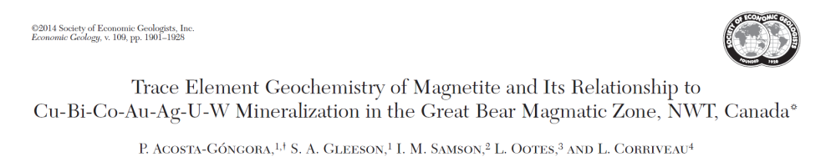
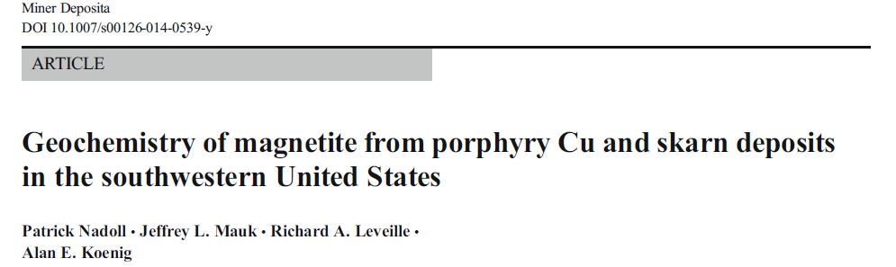
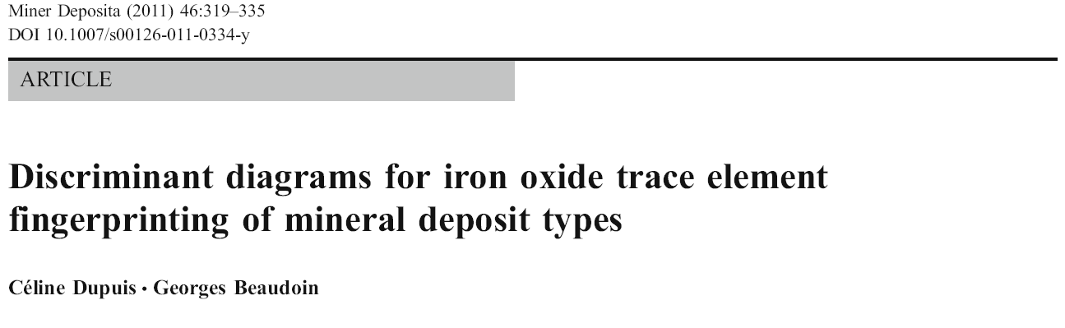
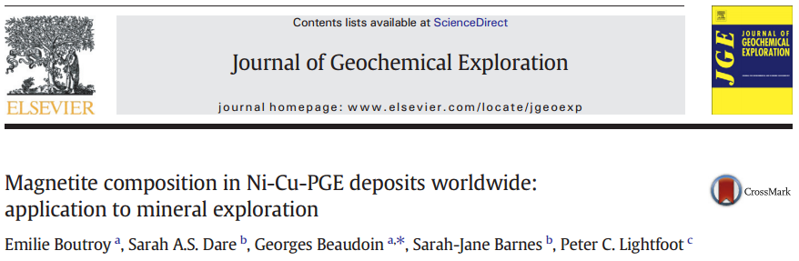
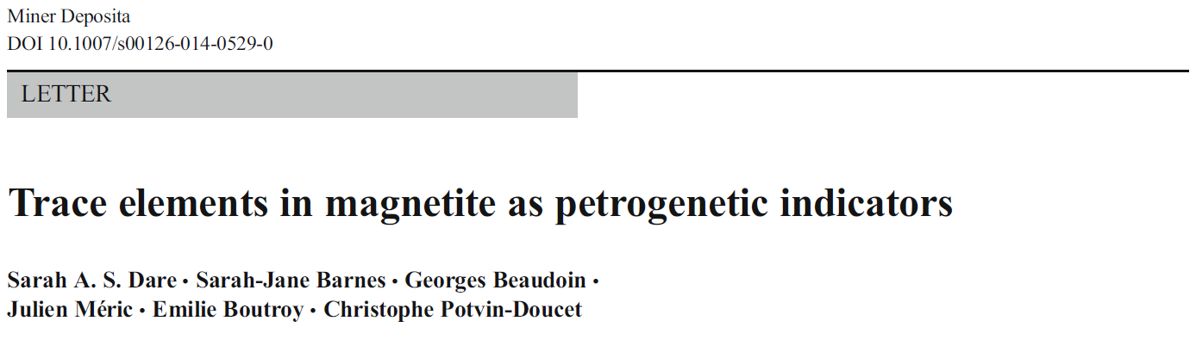
Magnetite as an indicator mineral for ore deposits
Numerous examples of recent studies which have used magnetite chemistry to elucidate ore forming processes:
and several more...
Why is magnetite useful for provenance studies and interpreting the petrogenesis of mineral deposits?
Bingham Canyon (Utah, USA)

Slide 4
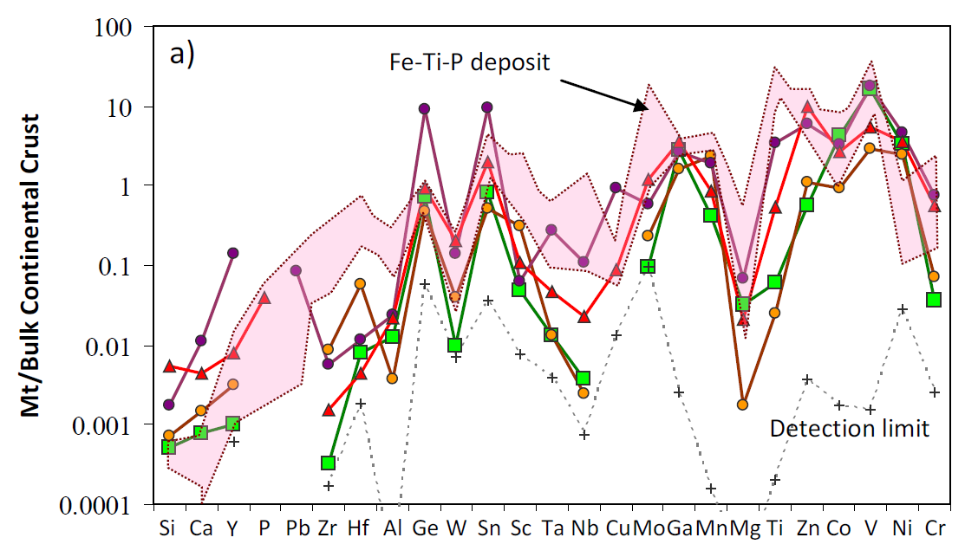
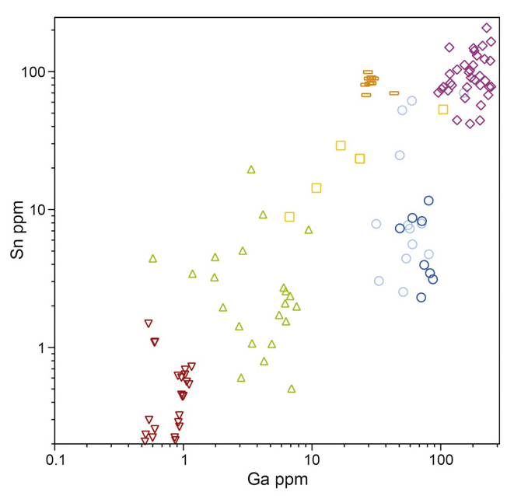
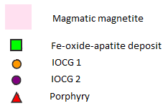
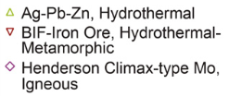

Magnetite as a petrogenetic indicator
Why magnetite?
  Partitions a large number of minor and trace elements (>25 detectable!)
  Forms under a wide variety of geologic conditions
      Crystallising at high T from silicate and sulphide melts
      Precipitating at low T from hydrothermal fluids
  The chemical composition of Fe-Ti oxides can be used to fingerprint their environment of formation (e.g. Dupuis and Beaudoin, 2011; Dare et al., 2012)
(Dare et al., 2013)
(Nadoll et al., 2014)
In order to use magnetite to interpret the petrogenesis of ore deposits, we must understand the factors which control its trace element chemistry
Bingham Canyon (Utah, USA)

Slide 5

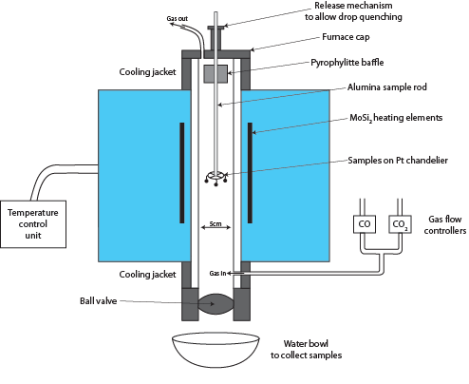
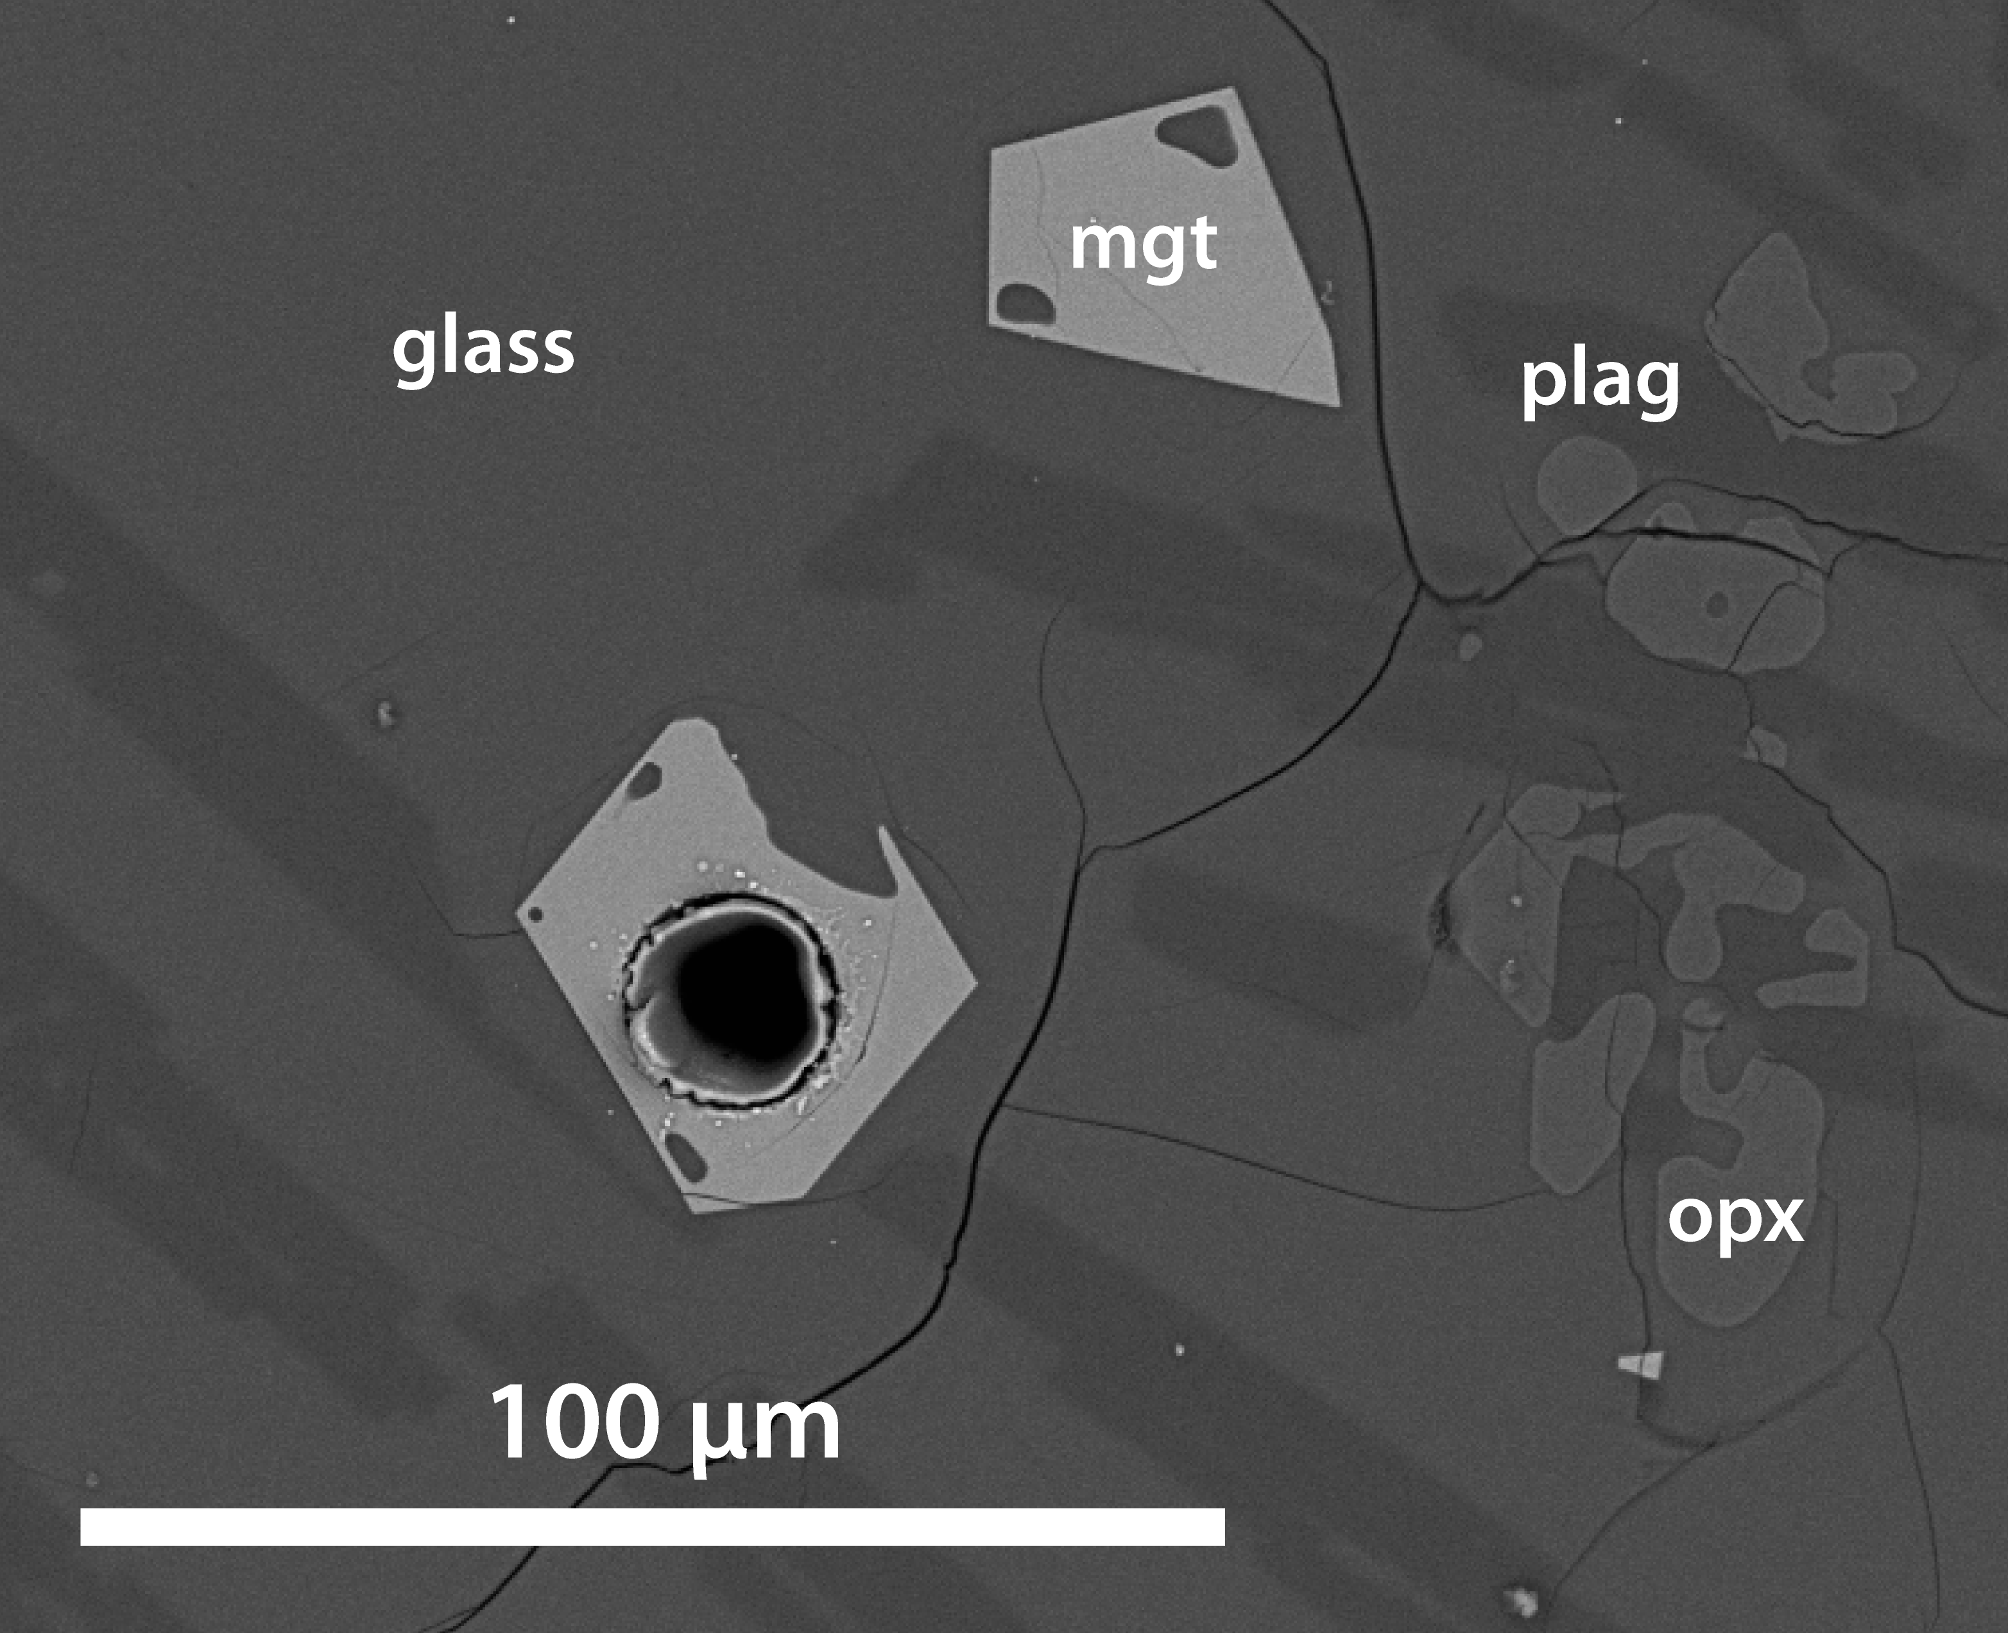
Example of experiments: Magnetite crystallisation experiments at 1-atm
Experimental design:
fO₂ range: FMQ to FMQ + 3.7
T: 1070-1120°C
Study full range of elements detectable using LA-ICP-MS
Run time: > 3 days @ final T (Sufficient time for close approach to equilibrium)
Starting materials:
Andesite
(And-190 – Henderson et al., 1985)
Andesite + 5 wt % Fe₂O₃
Dacite
(JA-1 – Geochemical standard )
Dacite
+ 5 wt % Fe₂O₃
Notes:
Typical arc magmas range between FMQ + 1 to FMQ + 3, whereas MORB basalts are homogeneously at FMQ.

Slide 6
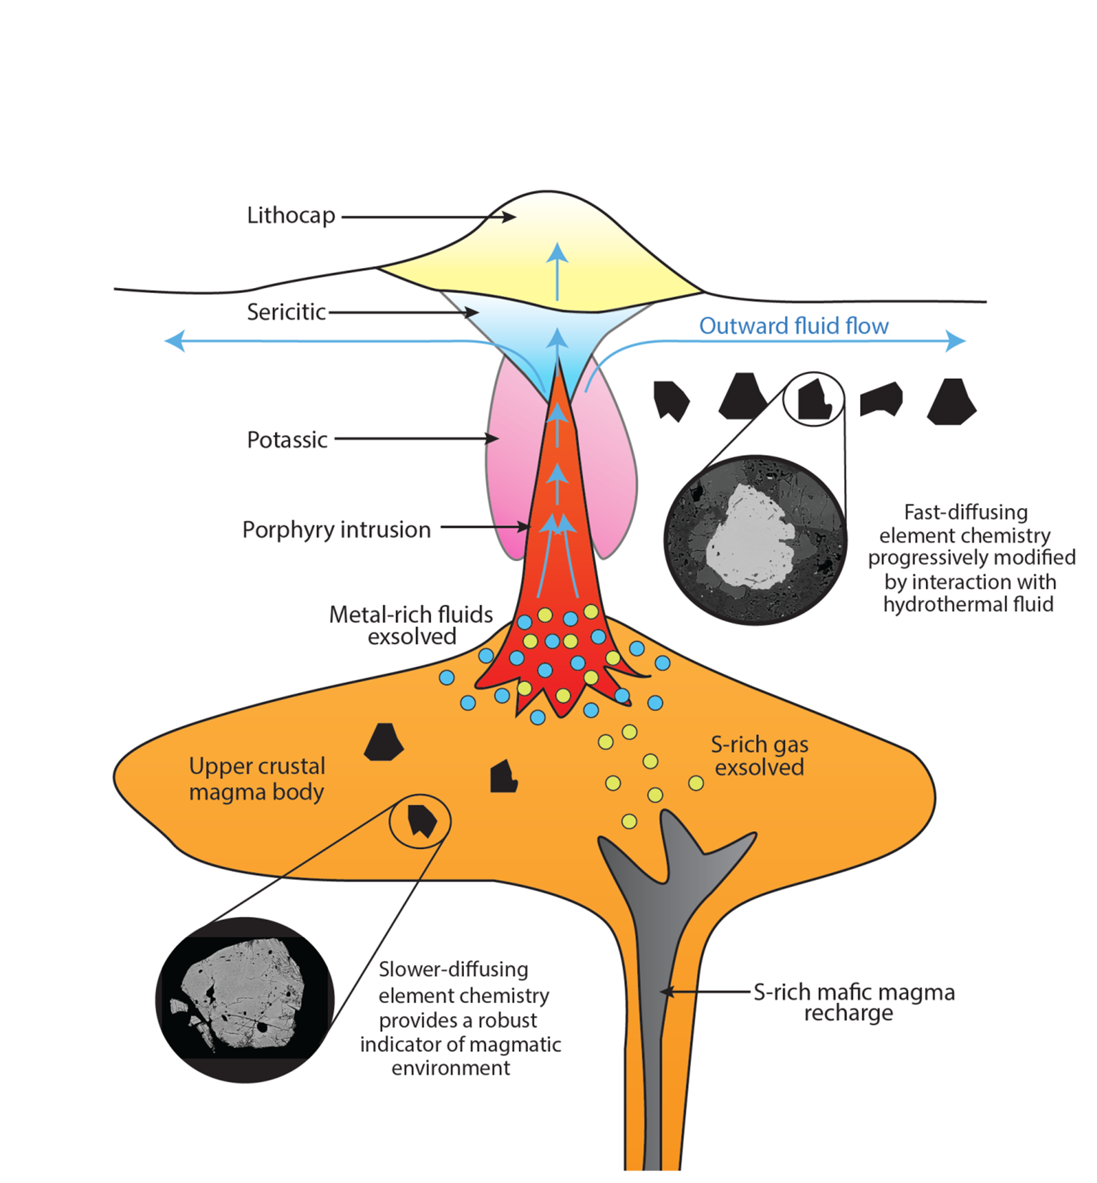
Geological implications
Magnetite as a petrogenetic indicator in ore deposit studies
Magnetite as an indicator of porphyry fertility
  Tracks latest magmatic episode prior to solidification owing to rapid diffusion
Chemistry primarily controlled by redox
  E.g. V/Ga as an indicator of magmatic redox state from magnetite chemistry alone
Fast diffusing element chemistry susceptible to modification by interaction with hydrothermal fluids
  E.g. Co and Ni as a vector towards the centre of overprinting hydrothermal system
Notes:
Other geological implications: Melt inclusion studies, timescales of interaction with new magma, overprinting chemistry.

Slide 7
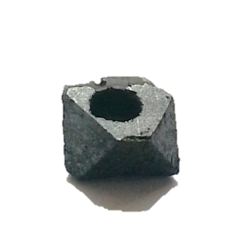
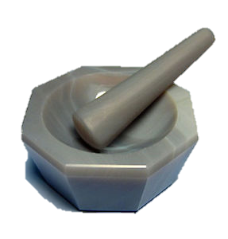
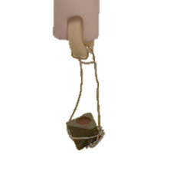
Diffusion experiments
Experimental procedure
Diffusion experiments were conducted by equilibration of a synthetic silicate melt with single crystals of natural magnetite (Fe = 72.4 wt. %) following a method analogous to Spandler & O’Neill (2010).
1) Preparation of Ca-Fe-Si starting material
2) Drilled hole in magnetite and filled with powdered starting material
3) Magnetite bucket hung in 1-atm furnace at specified conditions (T/fO₂/time)
Designed to be in equilibrium with magnetite at experimental conditions
Doped with 200ppm >22 trace elements
~ 6 mm
Experimental conditions
P = 1-atm Time: Up to 7 days
T = 1150°C fO₂: FMQ-1 to FMQ+4.89
constant
variable

Slide 8
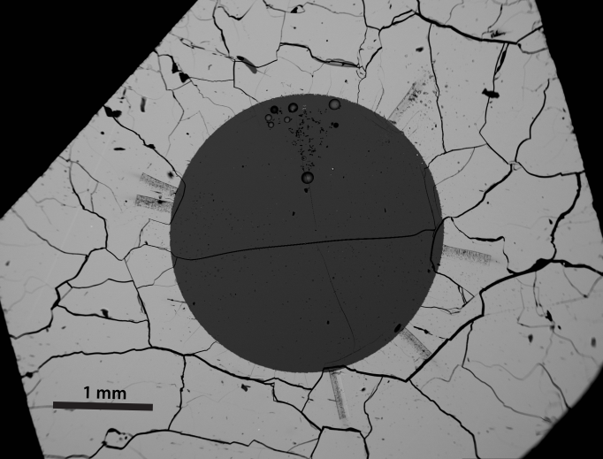

Slide 9
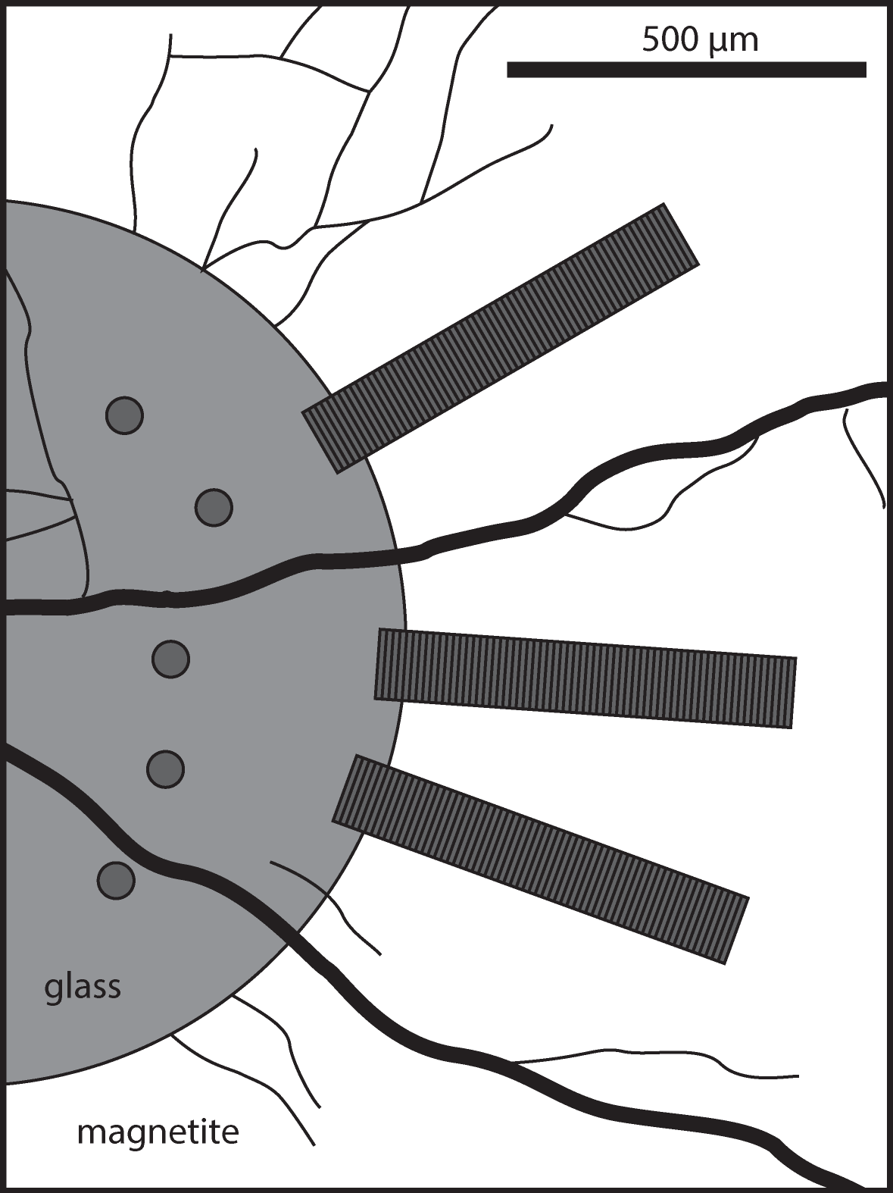
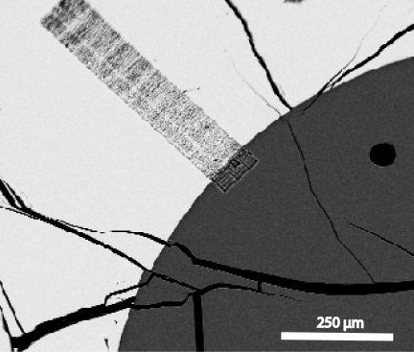
Diffusion experiments
Analytical procedure
LA-ICP-MS using 100 x 6 µm slit orientated parallel to the magnetite-melt interface
Sample traversed continuously beneath the laser at 1 µm/s
Traverses start within the magnetite and end by ablating clean glass

Slide 10


Element diffusion
FMQ + 1
T = 1150°C
t = 12h
$$\frac{c_{i}− c(x)}{c_{i}− c_{0}}=erf(\frac{x}{{2\left(D_{M}t\right)}^{\frac{1}{2}}})$$
logD_{Mn} = -13.09
logD_{Zn} = -13.66
Use known values:
c(x) = conc. at distance x
t = duration of experiment
To solve for:
c_{i} = conc. at mgt-melt interface
c_{o} = initial conc. in mgt
D_{M} = diffusion coefficient
Also solve partition coefficient
using:
logD_{Ni} = -13.63
logD_{Sc} = -14.51
logD_{U} = -13.34
$$K_{M}=\frac{c_{i}}{c_{melt}}$$
Figure: Representative diffusion profiles for Mn, Zn, Ni, Sc and U for an experiment at fO₂ = FMQ + 1, t = 12 hours. Solid grey curves represent the best fits to the data according to the diffusion equation.

Slide 11
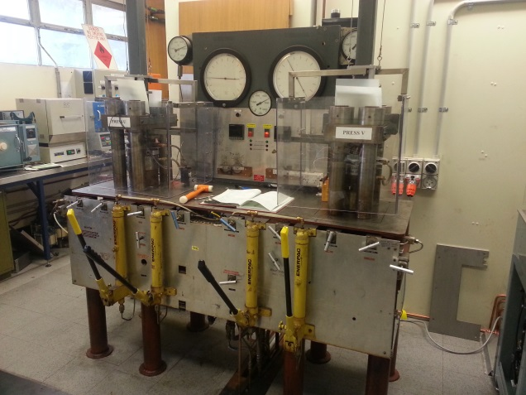
Magnetite crystallisation at pressure
Piston cylinder apparatus
P = 6-12 kbar
T = 920-980°C (hydrous) and 1070°C (anhydrous)
fO₂:
H₂O: 0 wt.% H₂O to 15 wt.% H₂O
Time: 2 days
Starting compositions:
1) And-190 + Fe₂O₃ + traces
2) And-190 + Fe₂O₃ + traces + FeS
BUFFER | Ni-NiO | Re-ReO₂ | Fe₃O₄ – Fe2O₃
ΔFMQ | FMQ + 0.67 | FMQ + 2.67 | FMQ + 4.46
And-190 + Fe2O3 + mgt seeds + H₂O
Elements of interest
  Sc, V, Al, Cr, Mn, Mg, Co, Ni, Cu, Zn, Ga, Ge Sr, Y, Zr, Nb, Ta, Hf, In – compare to 1-atm
  As, Mo, Sn, Sb, Pb, Cd, Tl, Re – Volatile (could not study at 1-atm)
  Th, U, W, REE
Ag
Capsule
Buffer
e.g. Re-ReO₂
Pressure
medium
Bingham Canyon (Utah, USA)

Slide 12
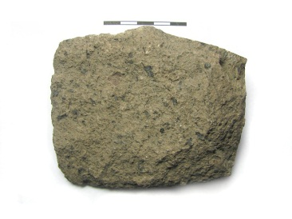
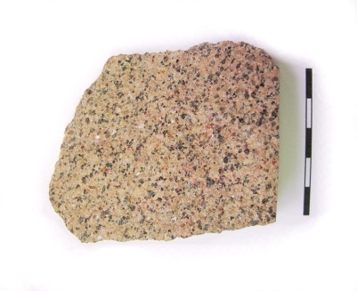
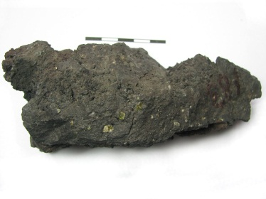
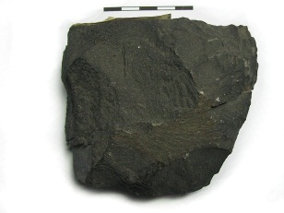
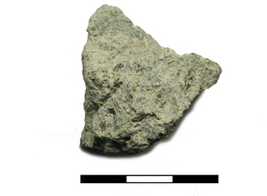
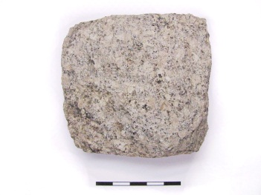
Implications of experiments for ore deposits studies
Melt composition exerts a strong control on mineral-melt partitioning of all divalent cations
  If studying mineral chemistry to elucidate ore forming processes, it is important to compare mineral chemistry from similar lithologies
Summary of titanomagnetite-melt partitioning controls
Cation | 1+ and 2+ cations (e.g. Mg²⁺, Mn²⁺, Co²⁺, Ni²⁺, Zn²⁺, Cu⁺ ,Li⁺ ) | 3+ cations |  |  | 4+, 5+ and 6+ cations (e.g. Ti⁴⁺, V⁴⁺, Zr⁴⁺, Hf⁴⁺, Nb⁵⁺, Ta⁵⁺, Mo⁶⁺, U⁴⁺, W⁶⁺, Ge⁴⁺)
 |  | Al³⁺ | Ga³⁺ | Sc³⁺
fO₂ | D(M²⁺) ↑ with ↑ fO₂ (especially silicic bulk compositions) | Not strongly sensitive | Not strongly sensitive | Not strongly sensitive | D(M⁴⁺/M⁵⁺⁺/M⁶⁺) ↑ with ↓ fO₂
T | D(M²⁺) ↑ with ↓ T | D(Al³⁺) ↑ with ↑ T | Not sensitive | D(Sc³⁺) ↑ with ↓ T | D(M⁴⁺/M⁵⁺⁺/M⁶⁺) ↑ with ↓ T
Bulk composition | fO₂ sensitive in intermediate to silicic bulk systems only | Not strongly sensitive | ? | ? | Not strongly controlled by bulk composition
Bingham Canyon (Utah, USA)

Slide 13
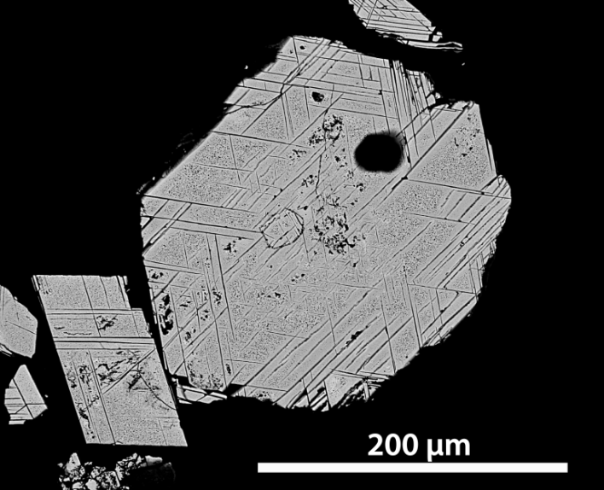
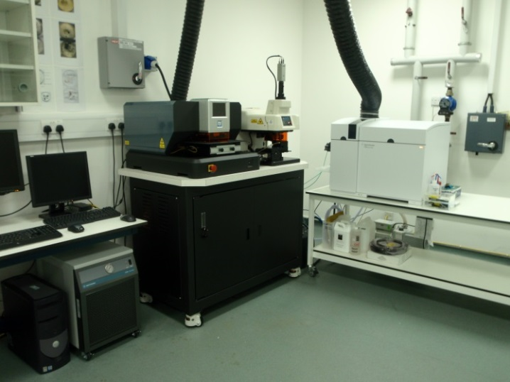
Phase 2 (Natural sample-set)
Developing method for LA-ICP-MS analysis of magnetite
  Calculating internal standard
    Ilmenite/Titanite exsolution
  External standards
    GSE-1g & GSD-1g (USGS synthetic glass)
    BCR-2g (USGS Basaltic glass)
    BC-28 (Natural magnetite from Bushveld – Dare et al., 2014)
  Laser ablation
    Spot/Line analysis
    Size of spot/line
    Frequency (5/10 Hz)
  Isotope interferences
  Elements above LOD
    Chalcophile elements (Cu, Sn, Sb, Pb, Zn, Mo)
    Sc, Co, Ni, Ga, Ge, V, Cr, HFSE, W, U, Th….
    REE?
      Be wary of inclusions though…
Figure: Titanomagnetite from Schultze granite, Arizona, USA with titanite exsolution
Figure: LODE LA-ICP-MS facility generously funded by Rio Tinto and Anglo American

Slide 14
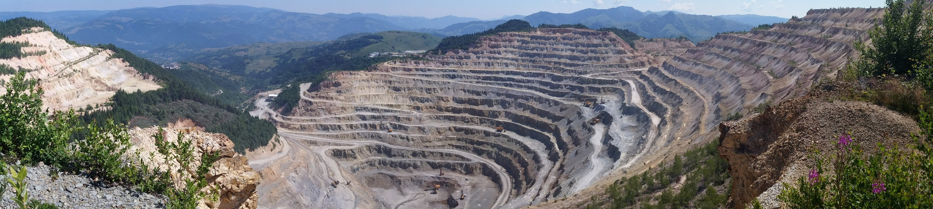
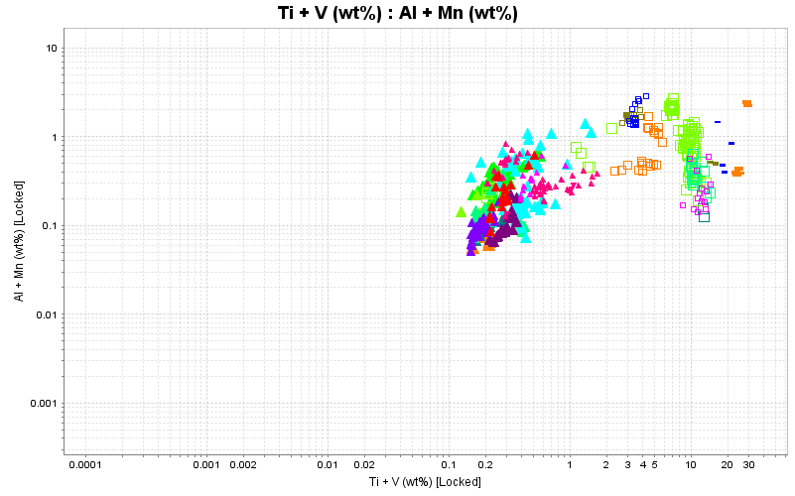
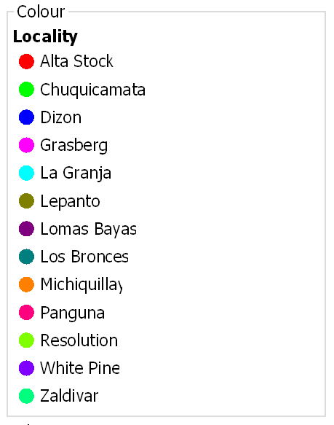


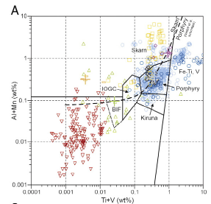
Analysis of natural igneous magnetite from porphyry-systems
Rosia Poini open-pit, Romania
Compare chemistry of magnetite from a variety of porphyry copper deposits worldwide
  Specific chemistry of magnetite from different metal associations (e.g. Cu/Cu-Au/Cu-Mo, Cu-Mo-Au)?
  Contrasting chemistry of magnetite from mineralised/less-mineralised/‘barren’ porphyry systems?
  Hydrothermal vs. Igneous mgt?
Current sample set (red = analysed):
Natural History Museum: Chuquicamata (Cu-Mo); Los Bronces (Cu-Mo); Michiquillay (Cu); Panguna (Cu-Au); Batu Hijau (Cu-Au), Grasberg (Cu-Au); Dizon (Cu-Au); Lepanto (Cu-Au)
RTX: White Pine (Cu); Alta Stock; GRP 314 (Cu-Au); Zaldivar (Cu-Mo); Copper Cliff (Cu); Taca Taca Bajo (Cu-Mo-Au); La Voluntad (Cu-Mo-Au); Lomas Bayas (Cu-Mo-Au); Bingham (Cu-Mo-Au); La Granja (Cu-Mo); Arroya de las Minas (Cu-Au) Resolution (Cu-Mo)
SEG field trip: Rosia Poeni (Cu-Au); Rovina Valley (Cu-Au); Valea Morii (Cu-Au); Majdanpek (Cu-Au); Veliki Krivelj (Cu-Au); Red River (Cu-Au); Elatsite (Cu-Au-Mo)
Preliminary data: (igneous mgt, hydrothermal mgt, and ilmenite)
Bingham Canyon (Utah, USA)
Nadoll et al. (2014)

Slide 15
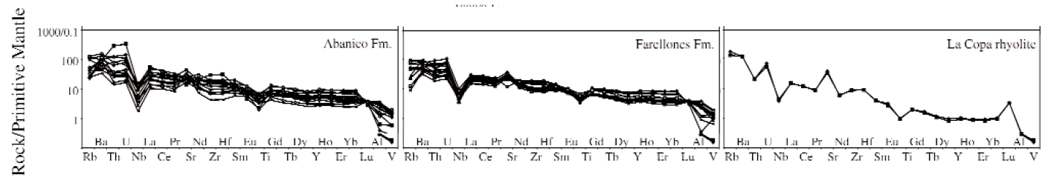
Analysis of natural igneous magnetite from porphyry-systems
Characterise chemistry of igneous magnetite from volcanic rocks pre-/syn-/post-mineralisation at a specific deposit:
  Case study: Los Bronces porphyry Cu-Mo deposit, Chile
  Hollings et al. (2005) – Regional Geochemistry of Tertiary Igneous Rock in Central Chile
    Tracked temporal changes in whole-rock chemistry of igneous rocks associated with El Teniente, Los Bronces-Rio Blanco and Los Pelambres-El Pachon
    Whole-rock chemistry indicates a rapid change in geochemical signature between Farellones formation and eruption of La Copa Rhyolite
    Chemistry of co-crystallising mineral phases remains to be studied
Abanico formation
(36-16 Ma)
Farellones formation
(18-15 Ma)
Plutonic episode
(20-7 Ma)
Mineralisation
(8-5 Ma)
La Copa formation
(4.5 Ma)
Figure: Temporal change in whole-rock geochemistry in volcanic rocks associated with Los Bronces, Chile
Bingham Canyon (Utah, USA)
Notes:
Mineral chemistry might correlate with whole-rock. Alternatively could track changes swallowed up by the whole rock signature. If so, mineral chemistry could be used as a tool to distinguish the fertile Farellones from the unproductive La Copa.

