Slide 1
Organizational forms of innovation activity
Complex of organizational forms
Inner firm forms of organization of innovation processes
inter-firm scientific and technical cooperation of innovation processes
small innovative forms
Innovative activity of large organizational forms.
Virtual firms

Slide 2

Organizational types of small enterprises:
Venture companies
Implementing firms
Engineering firms
Engineering firms
Innovation centers
Venture business is represented by independent small firms specializing in research, development, manufacture of new products.
Venture firms, as a rule, do not organize the manufacture of products, but transfer their development to other firms.

Slide 3
Technopark structures
Business incubators (a form of support for the formation and development of a new firm):
corporate;
public;
University;
private.
Technoparks are flexible scientific and production structures that represent a polygon for the creation and promotion of science-intensive products. Formed around large research institutes.
Technopolis is a more perfect form of combining science and production, including small towns - science cities, the development of which is determined by the activities of scientific and production complexes.

Slide 4

Aspects of management of innovative business

Slide 5

Market analysis
research of commodity and firm
structure of the market
analysis of consumer preferences and motivations
consumer segmentation and
the possible definition of free niches
the study of the company's macro environment
analysis of trade practices and
commercial standards of
conduct study of legislative base.

Slide 6

Stages of developing and creating a new product
Develop a new product strategy
Forming an idea
Evaluation of alternatives
Business analysis
Creating a prototype
Marketing Testing
Commercialization

Slide 7
Typical reasons for the failure of new products
"Blurring" of novelty of goods
Errors in the choice of the target market
Weak complex marketing-mix Imperfection of qualitative characteristics of the goods
Temporary errors
The discrepancy between the planned and actually necessary budget.

Slide 8
SWOT analysis
It is carried out with the purpose: the identification of the potential of force (S);
identification of weakness potential (W);
the establishment of opportunities (O) provided by the external environment; detection of threats (T) from the external environment.
After drawing up a list of strengths and weaknesses, as well as opportunities and threats, establish links between them.

Slide 9

Determination of the payback period
The payback period is one of the most common indicators for assessing the effectiveness of investments. The indicator is based not on profit, but on the cash flow with the reduction of the invested funds.
Payback period is the period of time for which discounted costs will be compensated by discounted incomes.

Slide 10
The impact of uncertainty and risk factors
Time factor
…
Risk of changes in
market conditions
Project Effectiveness
Evaluation
Lack of complete and
reliable information
Risk of price change
Deficiency of liquid
assets

Slide 11
When implementing innovation activities
The most likely risks are:
risks of rejection of innovation by the market;
risks of non-receipt of planned profits from innovation;
risks of inconsistency of actual parameters of innovation to the planned indicators; risks of non-receipt of the results of innovation activities to the deadline specified in the contract;
risks of infringement of patent rights of other patent holders;
risks of loss of know-how of the company.

Slide 12
Methods of risk reduction (risk management):
Insurance
Hedging - a way to reduce the risk of adverse changes in price conditions by the acquisition of futures contracts on the stock market (minimization of commercial risks).
Diversification is the minimization of the magnitude of credit risk due to the investment of multidirectional innovation projects.
Limiting - reducing the level of risk by setting limits on the amount of loans, financial resources used, sales volumes.

Slide 13
Forms of financing innovative activities:
Government funding;
Investments of collective investors;
Equity financing;
Bank loans;
Venture financing;
Leasing;
Foreign investments;
Mixed financing.

Slide 14
Problems of intellectual property in the innovation process

Slide 15
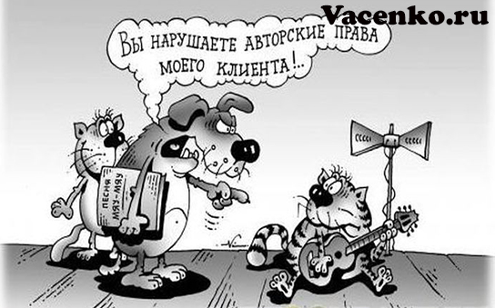
Intellectual property is a collective concept meaning the rights to concrete results of intellectual creative activity of a person in any field, as well as the rights to the means of individualization of a legal entity, products, works performed and services

Slide 16
Objects of intellectual property
Intellectual property
Objects of copyright
Objects of industrial property
Scientific discoveries
Special objects

Slide 17

Objects of copyright
Works of Science
Works of Literature
Works of Art

Slide 18
Objects of industrial property
Inventions
Trademarks, service marks
Industrial Designs
Place of origin of goods
Useful Models
Brand names
Suppression of unfair competition
Know-How

Slide 19

Scientific discoveries
Laws
Regularities
Effects

