Slide 1

Module 2
INNOVATION

Slide 2

Innovative management
Collecting and analyzing information
Setting goals for the innovation process
Developing common innovation strategies
Adopting management decisions
Planning for the innovation process by phases
Operational management
Accounting and control
Adjustment of goals and plans

Slide 3



Definitions of innovation
Innovations are purposefully carried changes in all spheres of the company's economic activity for adaptation to the external environment with the aim of achieving long-term effectiveness of the company

Slide 4
Changes by Schumpeter (American economist)
Use of new technology, new technological processes or new market support of production;
Introduction of products with new properties;
Use of new raw materials;
Changes in the organization of production and its logistics;
The emergence of new markets.

Slide 5

Innovation properties: novelty (scientific and technical) applicability (production) feasibility(commercial)

Slide 6
Components of innovation
Need
Concept
Technology

Slide 7
Classification of innovations
Innovations
Innovations with a technological dominant
Innovations with a commercial or marketing dominant

Slide 8
Innovations with a technological dominant
Innovation
Change in physical properties of the product at the production level
Applying a new component
Creating fundamentally new products
Creating new products
Creating a new physical state
Creation of new complex systems
Example
Creation of alloys and solders based on tin
Steel cord in tires
Polyurethane foam
Digital TV
Instant coffee
High-speed train

Slide 9
Innovations with a commercial or marketing dominant
Innovation
New payment method
A new combination of aesthetic and functional properties
New product presentation
The new form of trade
New type of advertising
New application of a known product
A new way of selling
Example
Credit card
Lighter combined with an opener
Pocket edition of the book (pocket)
Cash & Carry (store - store)
Posters at bus stops
Shampoo "2 in 1"
Online store

Slide 10

Definition
The innovation process is a creative process of creating and transforming scientific knowledge into new products recognized by consumers

Slide 11
Stages of the innovation cycle
Basic research
Applied Research
Design work
Mastering the production of products
Production of new products

Slide 12
Classification of innovations by object
Grocery
Marketing
Management
Technological

Slide 13
Definitions
Innovative management is a set of principles, methods and forms of management of innovation processes
Innovative process is actions to transform knowledge into innovation
The life cycle of a product (technology) is a collection of time periods from the beginning of the development of a product to its removal from production and sale

Slide 14

Definitions
An Innovative Project is a set of tasks and activities related to the achievement of a planned goal, which usually has a unique and non-repeating nature

Slide 15
Distinctive features of the innovation project
Strict and justified goals
The presence of internal and external relationships of operations, tasks and resources, which require clear coordination in the implementation of the project
Specific start and end dates for the project
Limited resources
A certain degree of uniqueness of the objectives of the project and the conditions for its implementation
The inevitability of various conflicts

Slide 16
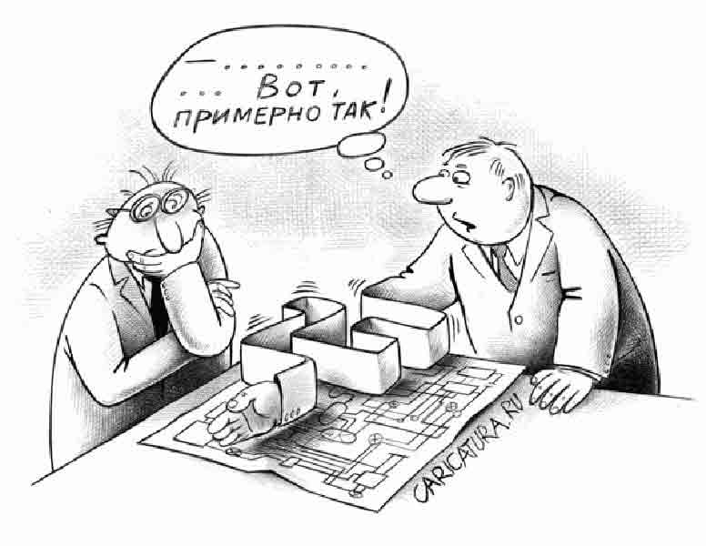
Definitions
Project management is a professional creative activity based on the use of modern knowledge, methods and technologies and focused on the achievement of goals through the implementation of projects as targeted changes while limiting financial, time, human, material and other resources

Slide 17
Criteria for the classification of projects
Criteria
Branch of economy and social sphere
Implementation period
Volume of necessary investments
Degree of coverage of IP stages

Slide 18

Project evaluation factors
Factors
Financial advantages
Impact on other projects
Impact on the economy of the organization

Slide 19
Estimation of market prospects of the project
Matching the project with clearly defined market needs
Estimation of total market capacity and market share
Evaluation of the period of product release
Probability of commercial success
Probable sales volume
Time aspect of the market plan Impact on existing products
Pricing and consumer perception
Position in the competitive struggle
Match existing distribution channels
Assessment of start-up costs

Slide 20
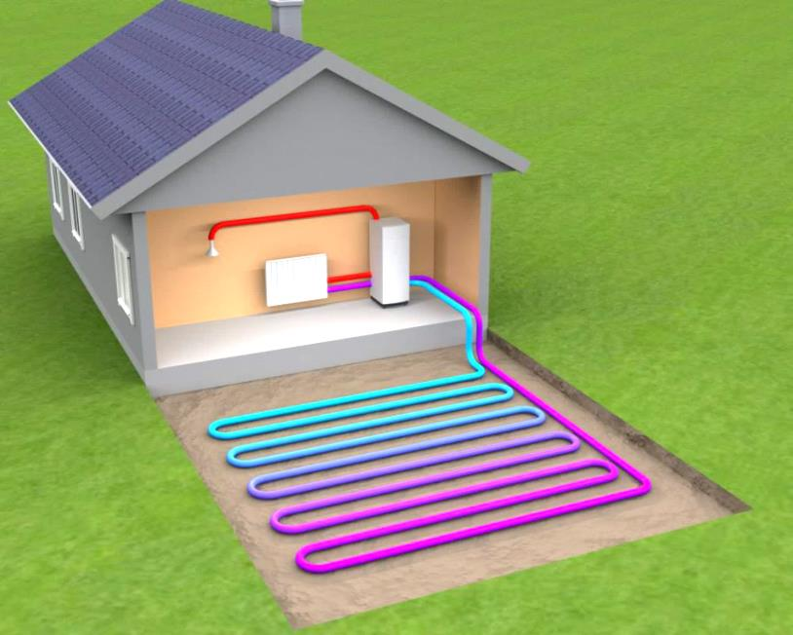
Scientific and technical criteria of the project
Compliance with the draft strategy of the company
Probability of technical success
Cost and development time
Patent cleanliness
Availability of scientific and technical resources
Possible future applications of the new generated technology
Impact on other projects

Slide 21

Financial criteria
The cost of research and development
Investments in production
Investments in marketing
Availability of finance at the right time
Potential annual profit

Slide 22
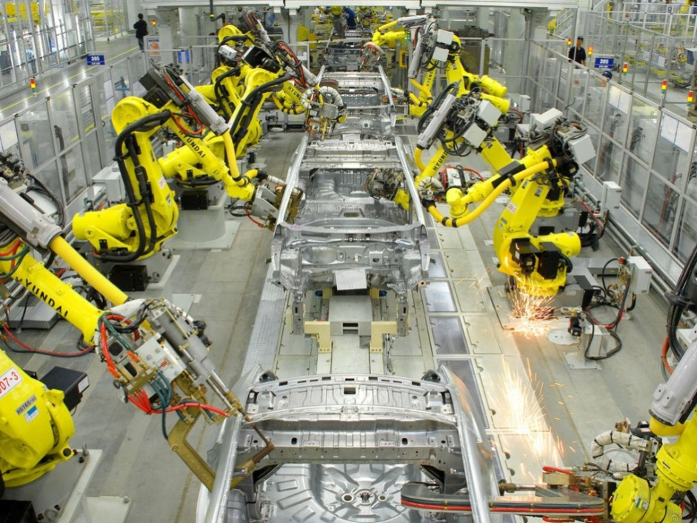
Production capabilities of the project
The need to introduce new processes
Availability of production personnel
Compliance with existing capacities
Price and availability of materials
Production costs
The need for additional capacity
Safety of production

Slide 23
Criteria for the evaluation of an innovation project
1 Advantage
2 Time
3 Sustainability

