Slide 1
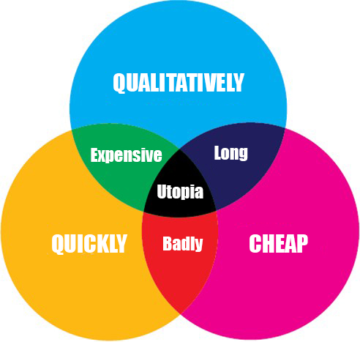

Slide 2
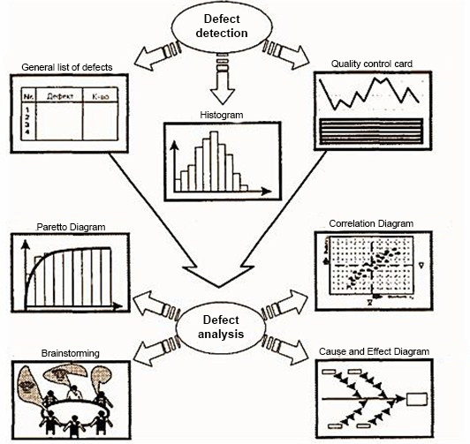
Seven quality tools

Slide 3
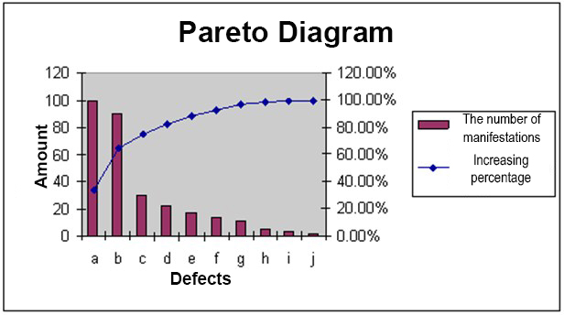


Slide 4

Benchmarking
(Benchmark - mark on fixed object)
“The art of discovering what others are doing better and learning / applying their working methods”
Comparison of the current or planned project with other comparable projects in order to identify best practices, develop ideas for improvement and define performance evaluation criteria.

Slide 5
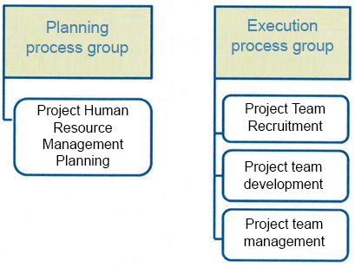

Human Resource Management Project

Slide 6
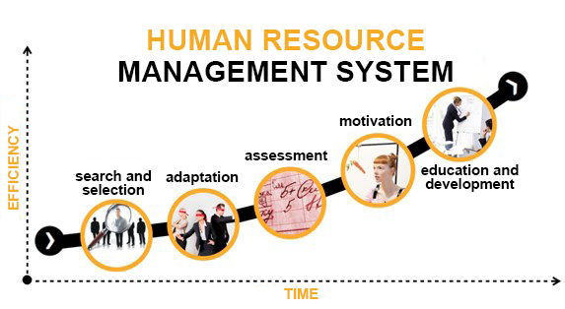

Slide 7

Develop Human Resource Plan
- The process of defining and documenting roles, responsibilities, required skills and accountability, and creating a management plan to ensure the project personnel.

Slide 8
Roles and Responsibilities
Role. Designation of the part of the project, the responsibility for the implementation of which is borne by a certain person.
Powers. The right to use project resources, make decisions and approve actions or results.
A responsibility. The work that a member of the project team must perform to complete the project operations
.
Qualification. skills and abilities required to perform project operations.

Slide 9
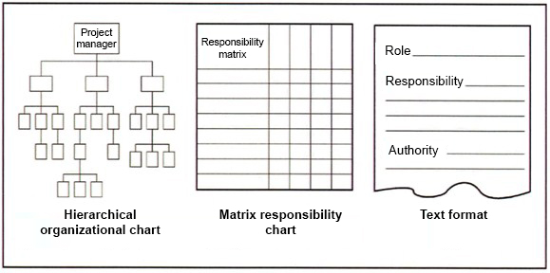
Organization Chart

Slide 10
Matrix of responsibility (MO) in RACI format
Responsible | Answers
Accountable | Approves Facilitates the implementation Performs
Consult | Consults
Inform | Receives information

Slide 11
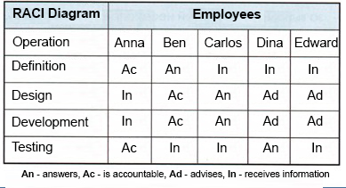
Matrix of responsibility (MO) in RACI format

Slide 12
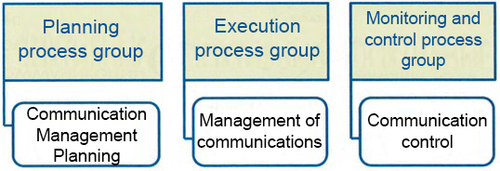

Project Communication Management

Slide 13

Plan Communications
Identifying information needs of project stakeholders and defining a communication approach.
Total number of communication channels:
n - the number of stakeholders of the project

Slide 14
Communication methods
1. Interactive communication
There is a multilateral exchange of information between two or more parties. Most effective for ensuring a common understanding of certain issues by all stakeholders (meetings, telephone, video conferencing)
2. Communication method of informing without a request.
Information is sent to recipients who need to know about it. This method ensures the dissemination of information, but does not guarantee that it will be actually received or understood (letters, reports, notes, SMS).

Slide 15

Communication methods
3. Communication method of informing on request.
It is used for very large volumes of information or for very large audiences when it is required that recipients refer to the transmitted content at will (websites, data banks, etc.)

Slide 16
THANKS FOR ATTENTION!!!

